Slide 1
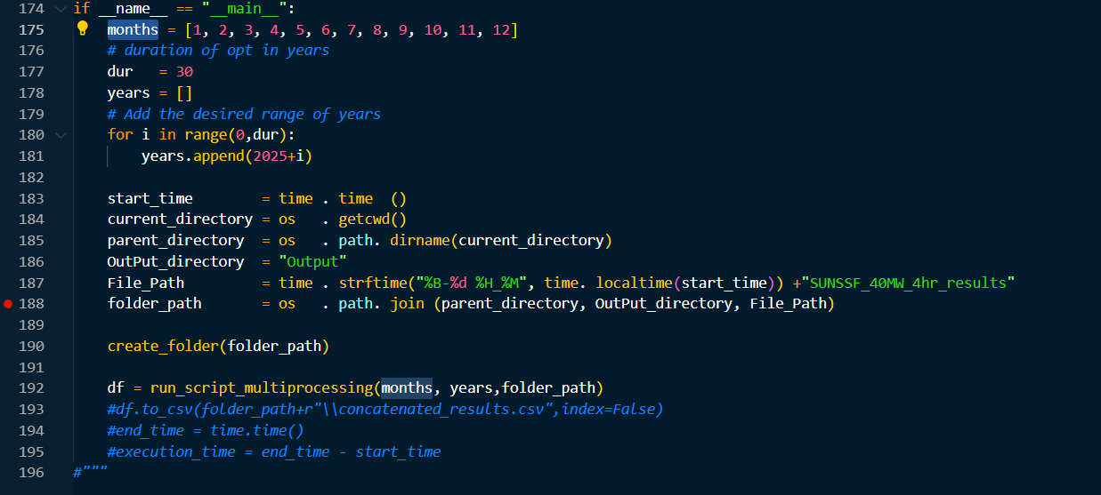


Slide 2
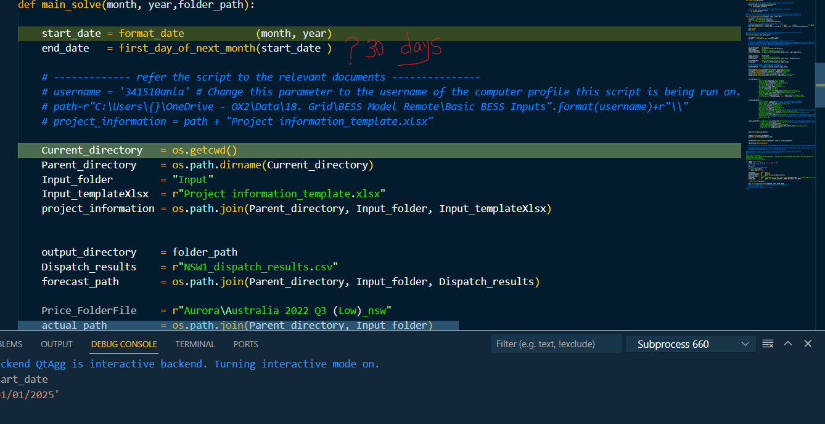

Slide 3
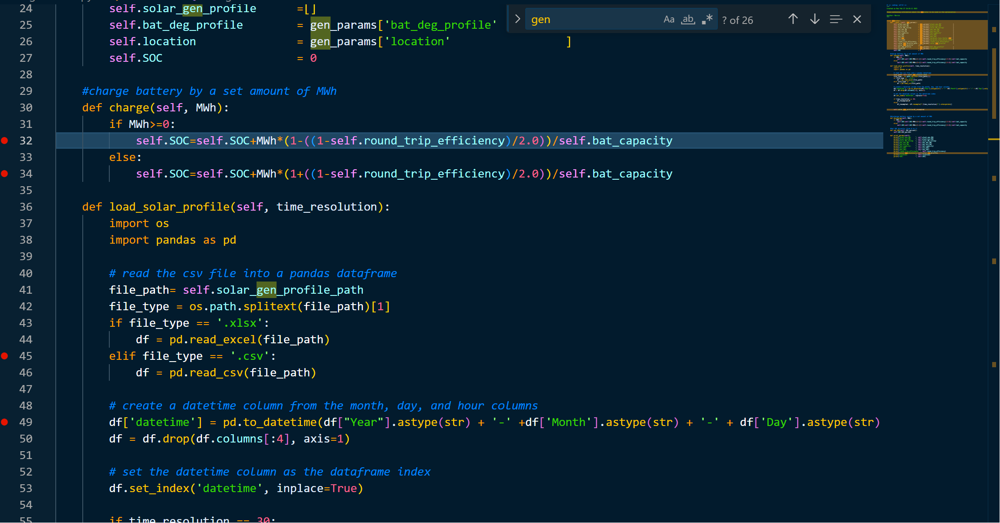



Slide 4
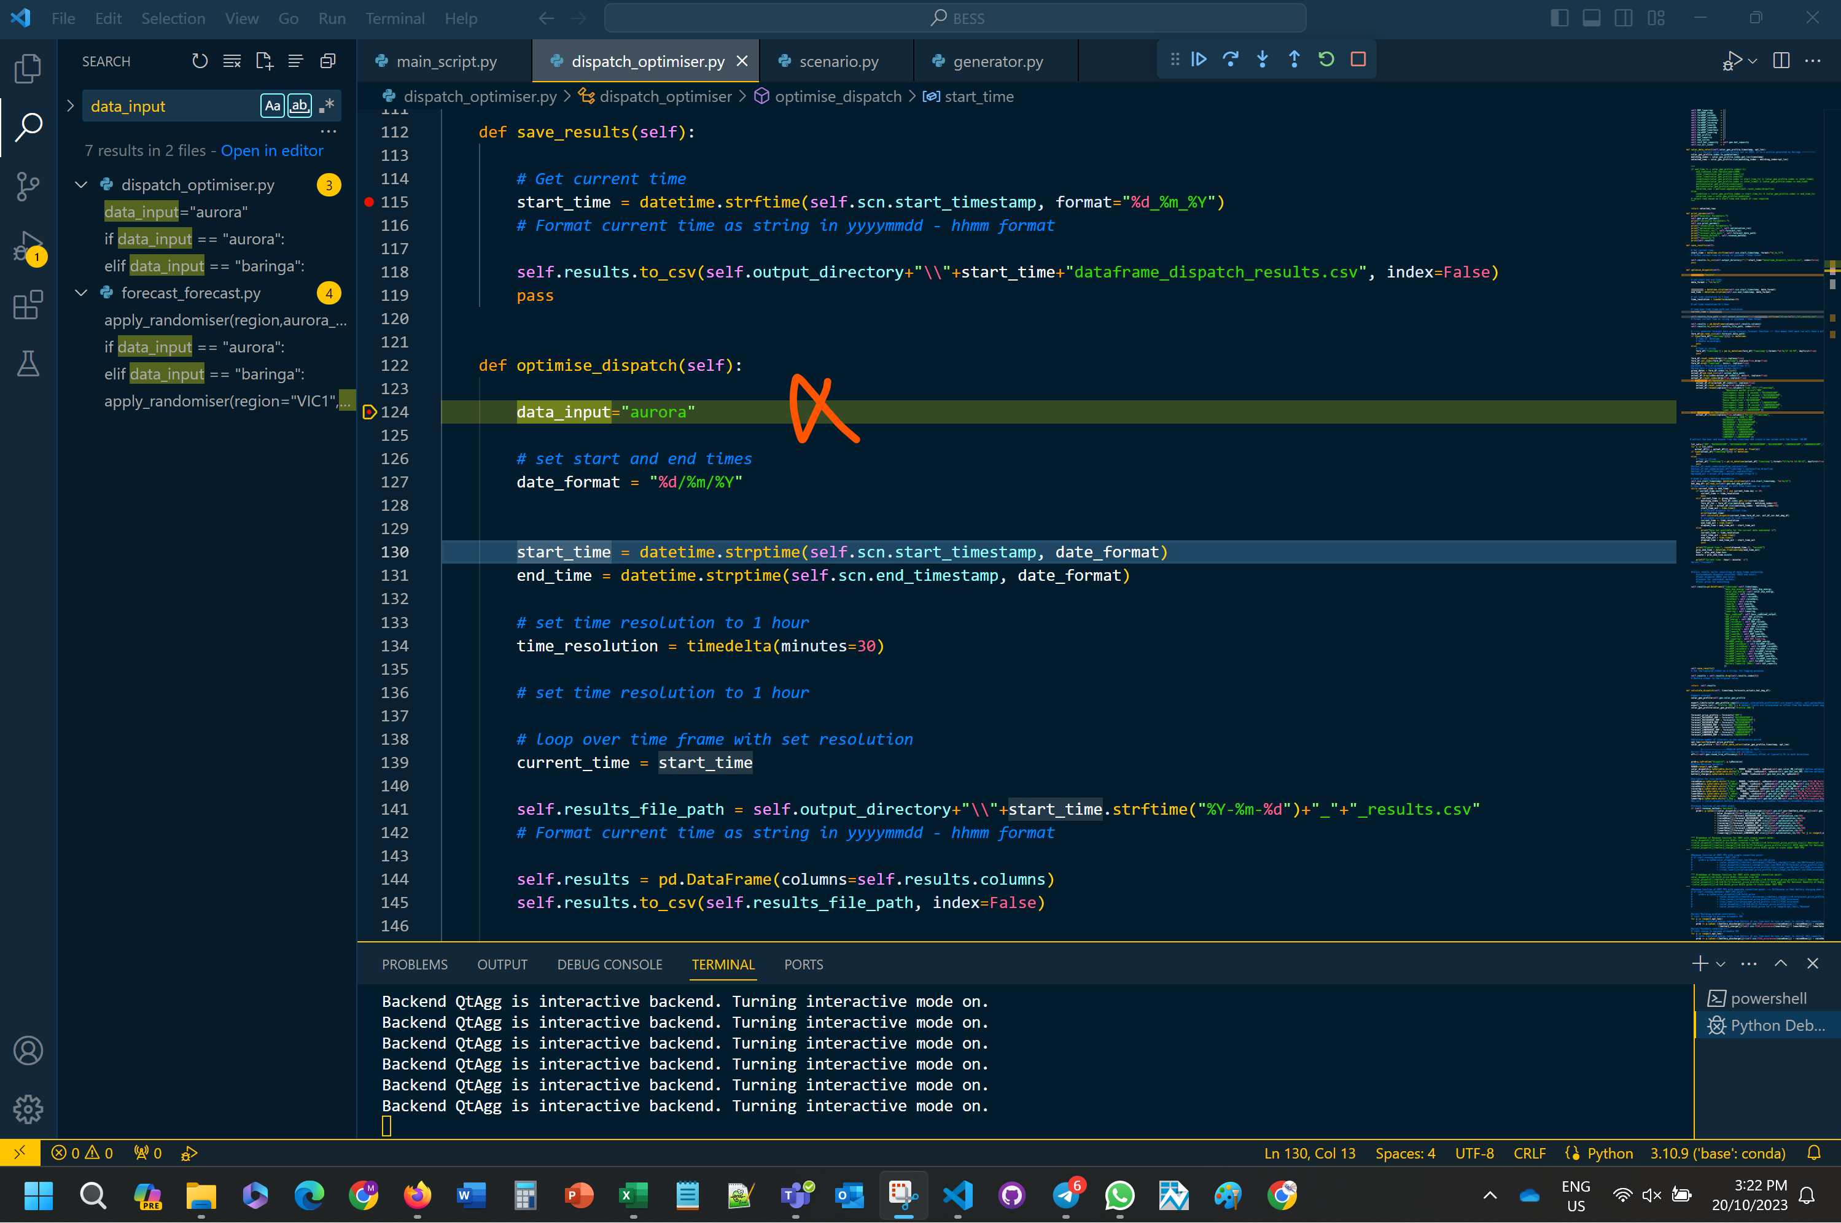
One month?
Can we make it Scenario base?
Slows down? Append and save as variable?

Slide 5
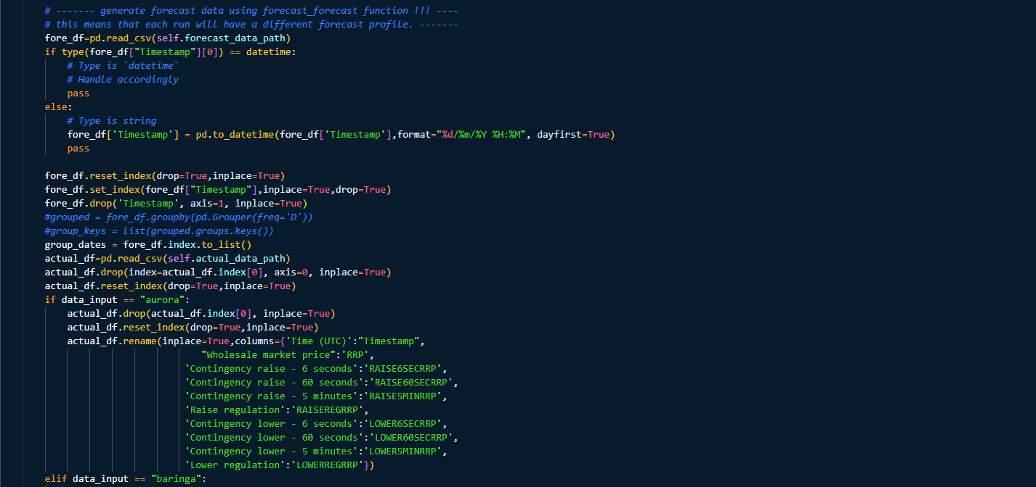
What is the point of generating some scenarios around the forecast?

